Slide 1

Music Genre Classification
Eduardo Cruz, Ethan Ngo, Kevin Tang, Justin Vuong

Slide 2
Project Description
Given a dataset of music entries with their features, the goal of this project is to develop a machine learning model that determines if a song belongs to the rock genre.

Slide 3




Tools Used
Python was used to create several prediction models and import various machine learning libraries.
NumPy provided support for creating arrays that stored our dataset.
Pandas library provided us with a DataFrame that helped us analyze our dataset.
Matplotlib library was used to visualize the data related to our dataset and prediction model via plots.

Slide 4
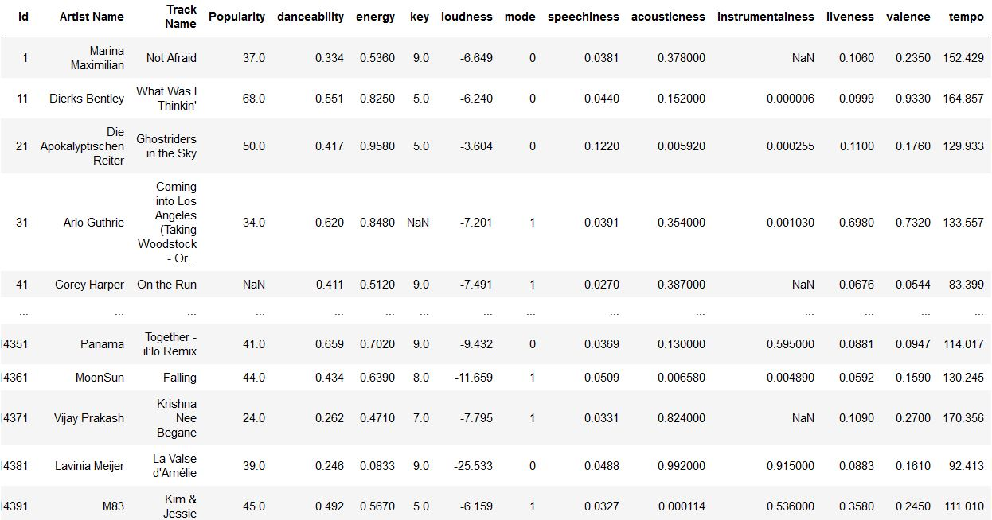
Dataset Information
Dataset consists of features such as energy, loudness, acousticness, and more. Labels are represented by values in the range 0-10 for the ‘Class’ column.

Slide 5
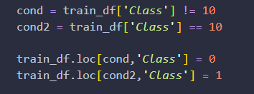
Dataset Information
The dataset has labels in the range of 0-10 with each number corresponding to a specific genre such as Jazz, HipHop, and Country.
In order to keep the project simpler and more feasible, the TA suggested that we convert the data into one with binary classification.
Thus, instead of having our ‘Class’ column span 10 different numbers (0-10), we instead redefined it such that it contains 1’s and 0’s, with 1 corresponding to a music entry that “is a rock song” and 0 meaning the music entry “is NOT a rock song”.

Slide 6

Challenges
The dataset description did not specify the name of the genre associated with each music entry.
This prompted the need to manually find the genre of numerous music entries in order to determine which label value represented ‘rock’.
Once we noted down enough genres belonging to several music entries, we were able to establish a pattern of song entries under the ‘rock’ genre, narrowing down the our required label value to 10.

Slide 7

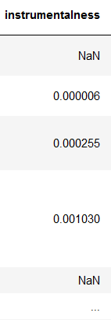
Challenges (cont.)
Some feature columns in our DataFrame contained undefined column values (NaN), which created a roadblock for the process of randomly splitting the original dataset into training and testing sets.
Temporary Fix: Used functions provided by the NumPy library to replace NaN values with the mean of all values in that same feature column.

Slide 8
Developed Algorithms
For this project, we created and tested three prediction models based on the following algorithms:
Random Forest Classifier
Decision Tree Classifier
K-Nearest Neighbors (KNN) Classifier

Slide 9
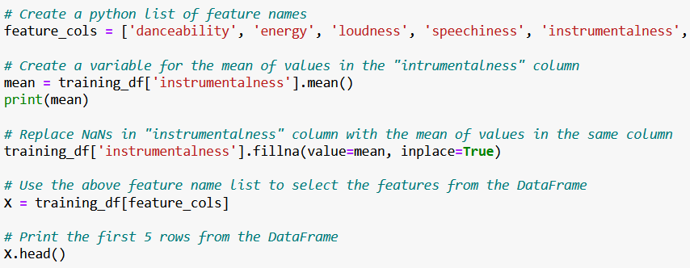
Temporary Fix Code for “Instrumentalness” Column

Slide 10
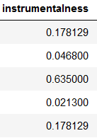
Temporary Fix for “Instrumentalness” Column
Replace NaN values with mean of all entries in the feature column instrumentalness.
Mean for this column is 0.178129, so this value will replace all NaN values that exist.
This same process was repeated for the ‘Popularity’ and ‘key’ feature columns as they also contained NaN values

Slide 11
Challenges (cont.)
While this solution resolved the error during the data splitting process it also changed the accuracy of the results when compared to just ignoring the features with NaN values.
In our testing, the random forest and K neighbors classifiers saw a slight increase in accuracy and AUC while the decision tree classifier saw a slight decrease in accuracy and AUC.
The decrease is likely due to the mean value not corresponding with the features of specific music entries.
An example of this is the feature column “instrumentalness”, which determines whether or not a song includes vocals. If the mean of this feature column isn’t applicable to a music entry, then this results in false music classifications.

Slide 12
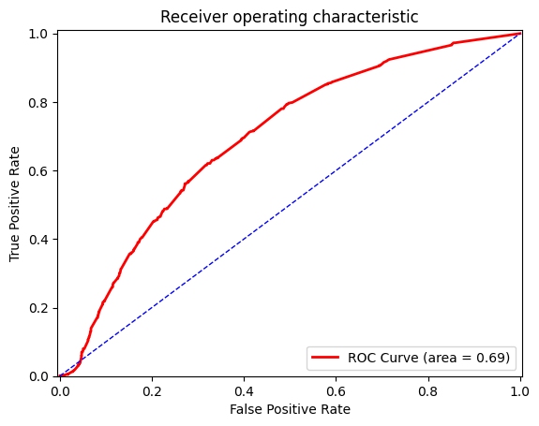
Accuracy Evaluation (Random Forest)
This approach includes the feature columns containing NaN values.
Accuracy score of Random Forest approach: 70.6%
The AUC of the Random Forest is:
0.69

Slide 13
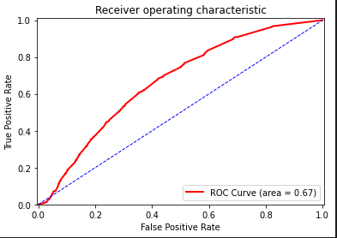
Accuracy Evaluation (Random Forest)
This approach does NOT include the feature columns containing NaN values.
Accuracy score of Random Forest approach: 68.6%
The AUC of the Random Forest is:
0.67

Slide 14
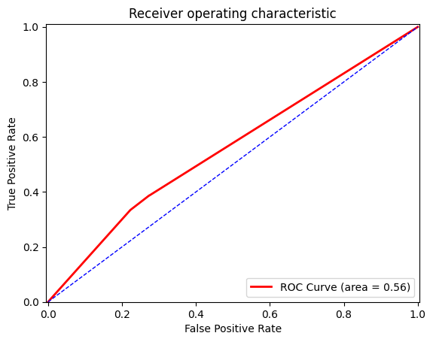
Accuracy Evaluation (Decision Tree)
This approach includes the feature columns containing NaN values.
Accuracy score of Decision Tree approach:
64.9%
The AUC of the Decision Tree is:
0.56

Slide 15
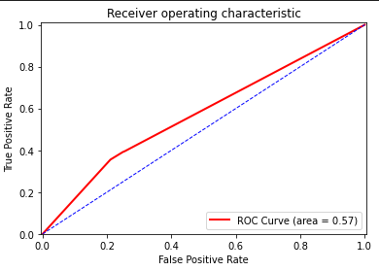
Accuracy Evaluation (Decision Tree)
This approach does NOT include the feature columns containing NaN values.
Accuracy score of Decision Tree approach:
66.4%
The AUC of the Decision Tree is:
0.57

Slide 16
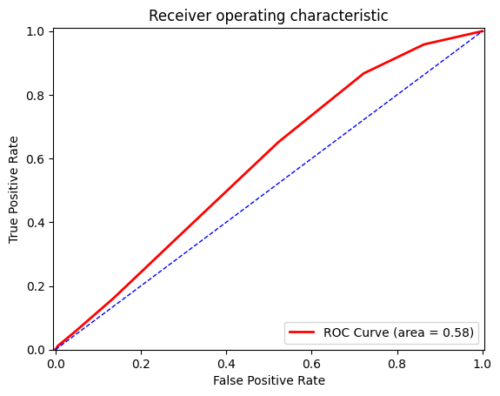
Accuracy Evaluation (KNN)
This approach includes the feature columns containing NaN values.
Accuracy score of KNN approach: 69.4%
The AUC of the KNN is:
0.58

Slide 17
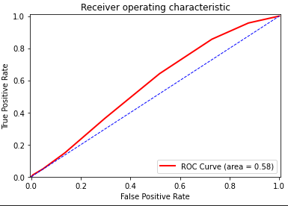
Accuracy Evaluation (KNN)
This approach does NOT include the feature columns containing NaN values.
Accuracy score of KNN approach:
69.2%
The AUC of the KNN is:
0.58

